Slide 1
Classes ,Objects and Methods

Slide 2
Ms. Priti P.Bokariya
Lecturer, Computer Engineering dept.
SBMP

Slide 3
class fundamentals

Slide 4
In Java, a class is a blueprint for creating objects.
It defines a type by bundling data and methods that work on the data into one single unit.

Slide 5
Declaring Classes
class MyClass
{
// field, constructor, and
// method declarations
}
This is a class declaration.
The class body (the area between the braces) contains all the code that provides for the life cycle of the objects created from the class:
constructors for initializing new objects,
declarations for the fields that provide the state of the class and its objects
and methods to implement the behavior of the class and its objects.

Slide 6
Declaring Member Variables
There are several kinds of variables:
Member variables in a class—these are called fields.
Variables in a method or block of code—these are called local variables.
Variables in method declarations—these are called parameters.
Field declarations are composed of three components, in order:
Zero or more modifiers, such as public or private
The field's type
The field's name

Slide 7
Access Modifiers
The first (left-most) modifier used lets you control what other classes have access to a member field.
public modifier—the field is accessible from all classes.
private modifier—the field is accessible only within its own class.
In the spirit of encapsulation, it is common to make fields private.
This means that they can only be directly accessed from the Bicycle class.
We still need access to these values, however.
This can be done indirectly by adding public methods that obtain the field values for us:

Slide 8
class declarations can include these components, in order:
Modifiers such as public, private, and a number of others that you will encounter later. (However, note that the private modifier can only be applied to Nested Classes.)
The class name, with the initial letter capitalized by convention.
The name of the class's parent (superclass), if any, preceded by the keyword extends. A class can only extend (subclass) one parent.
A comma-separated list of interfaces implemented by the class, if any, preceded by the keyword implements. A class can implement more than one interface.
The class body, surrounded by braces, {}.

Slide 9
Here's the general form of a class in Java:

Slide 10
// Class declarationpublic
class ClassName
{
// Fields (variables)
private dataType fieldName;
// Constructors public ClassName()
{
// Initialization code
}
public ClassName(dataType parameter)
{
this.fieldName = parameter;
}
// Methods
public returnType methodName()
{
// Method code
return value;
}
// Getters and Setters for fields
public dataType getFieldName()
{
return fieldName;
}
public void setFieldName(dataType fieldName)
{
this.fieldName = fieldName;
} // Other methods
public void anotherMethod()
{ // Method code
}
}

Slide 11
public static void main(String[] args)
{
// Create a Scanner object to read input from the user
Scanner scanner = new Scanner(System.in);
// Prompt user for name and age
System.out.print("Enter name: ");
String name = scanner.nextLine(); System.out.print("Enter age: ");
int age = scanner.nextInt();
// Create a Person object using the parameterized constructor
Person person = new Person(name, age);
// Display the person's information
person.displayInfo();
// Close the scanner
scanner.close();
}
} //end of class
public class Person
{
// Fields
private String name;
private int age;
// Default constructor
public Person()
{
this.name = "Unknown";
this.age = 0;
}
// Parameterized constructor
public Person(String name, int age)
{
this.name = name;
this.age = age;
}
// Method to display person information
public void displayInfo()
{
System.out.println("Name: " + name + ", Age: " + age);
}

Slide 12
Objects in Java
A typical Java program creates many objects, which as you know, interact by invoking methods.
Through these object interactions, a program can carry out various tasks, such as implementing a GUI, running an animation, or sending and receiving information over a network.
Once an object has completed the work for which it was created, its resources are recycled for use by other objects.

Slide 13
Here's a small program, called CreateObjectDemo, that creates three objects: one Point object and two Rectangle objects. You will need all three source files to compilepublic
class CreateObjectDemo {
public static void main(String[] args) {
// Declare and create a point object and two rectangle objects.
Point originOne = new Point(23, 94);
Rectangle rectOne = new Rectangle(originOne, 100, 200);
Rectangle rectTwo = new Rectangle(50, 100);
// display rectOne's width, height, and area
System.out.println("Width of rectOne: " + rectOne.width);
System.out.println("Height of rectOne: " + rectOne.height);
System.out.println("Area of rectOne: " + rectOne.getArea());
// set rectTwo's position
rectTwo.origin = originOne;
// display rectTwo's position
System.out.println("X Position of rectTwo: " + rectTwo.origin.x);
System.out.println("Y Position of rectTwo: " + rectTwo.origin.y);
// move rectTwo and display its new position
rectTwo.move(40, 72);
System.out.println("X Position of rectTwo: " + rectTwo.origin.x);
System.out.println("Y Position of rectTwo: " + rectTwo.origin.y);
}
}

Slide 14
Creating Objects
As you know, a class provides the blueprint for objects; you create an object from a class. Each of the following statements taken from the CreateObjectDemo program creates an object and assigns it to a variable:
Point originOne = new Point(23, 94);
Rectangle rectOne = new Rectangle(originOne, 100, 200);
Rectangle rectTwo = new Rectangle(50, 100);
The first line creates an object of the Point class, and the second and third lines each create an object of the Rectangle class.

Slide 15
Object creation statement has three parts as:
Declaration: variable declarations that associate a variable name with an object type.
Instantiation: The new keyword is a Java operator that creates the object.
Initialization: The new operator is followed by a call to a constructor, which initializes the new object.
Point originOne = new Point(23, 94);
Declaration
Initialization
Instantiation

Slide 16
Declaring a Variable to Refer to an Object
Previously, you learned that to declare a variable, you write:
type name;
This notifies the compiler that you will use name to refer to data whose type is type.
With a primitive variable, this declaration also reserves the proper amount of memory for the variable.You can also declare a reference variable on its own line.
For example:
Point originOne;
If you declare originOne like this, its value will be undetermined until an object is actually created and assigned to it.
Simply declaring a reference variable does not create an object.
For that, you need to use the new operator, as described in the next section. You must assign an object to originOne before you use it in your code. Otherwise, you will get a compiler error.
A variable in this state, which currently references no object, can be illustrated as follows
(the variable name, originOne, plus a reference pointing to nothing):

Slide 17
Instantiating a Class
The new operator instantiates a class by allocating memory for a new object and returning a reference to that memory. The new operator also invokes the object constructor.
Note: The phrase "instantiating a class" means the same thing as "creating an object." When you create an object, you are creating an "instance" of a class, therefore "instantiating" a class.
The new operator requires a single, postfix argument: a call to a constructor. The name of the constructor provides the name of the class to instantiate.
The new operator returns a reference to the object it created. This reference is usually assigned to a variable of the appropriate type, like:
Point originOne = new Point(23, 94);
The reference returned by the new operator does not have to be assigned to a variable. It can also be used directly in an expression. For example:
int height = new Rectangle().height;
This statement will be discussed in the next section.

Slide 18
Code for the Point class
public class Point {
public int x = 0;
public int y = 0;
//constructor
public Point(int a, int b)
{
this.x = a;
this.y = b;
}
}

Slide 19
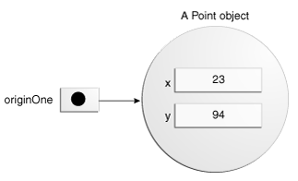
Initializing an Object
This class contains a single constructor. You can recognize a constructor because its declaration uses the same name as the class and it has no return type.
The constructor in the Point class takes two integer arguments, as declared by the code (int a, int b). The following statement provides 23 and 94 as values for those arguments:
Point originOne = new Point(23, 94);
The result of executing this statement can be illustrated in the next figure:

Slide 20
Point originOne = new Point(23, 94);
1.Declaration
2.Instantiation
3.Initialization
Point Object
23
94
OriginOne
x
y

Slide 21
Code for the Rectangle class
public class Rectangle
{
public int width = 0;
public int height = 0;
public Point origin;
// four constructors
public Rectangle()
{
origin = new Point(0, 0);
}
public Rectangle(Point p)
{
origin = p;
}
public Rectangle(int w, int h)
{
origin = new Point(0, 0);
width = w;
height = h;
}
public Rectangle(Point p, int w, int h)
{
origin = p;
width = w;
height = h;
}

Slide 22
// a method for moving the rectangle
public void move(int x, int y) {
origin.x = x;
origin.y = y;
}
// a method for computing the area of the rectangle
public int getArea() {
return width * height;
}
}//end of class

Slide 23
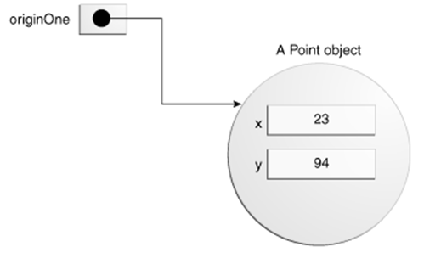
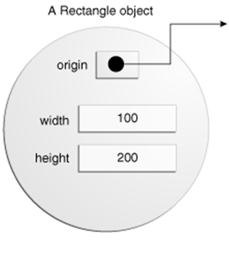
Rectangle rectOne = new Rectangle(originOne, 100, 200);
rectOne

Slide 24
Constructors in Java

Slide 25
Definition: Constructors are special methods in Java that are called when an object is instantiated.
Purpose: They initialize the object's state (fields) and perform any necessary setup operations.

Slide 26
Types of Constructors
Default Constructor
Parameterized Constructor
Copy Constructor

Slide 27
Default Constructor:
A constructor with no parameters.
public class Car
{
public Car()
{ // Initialization code
}
}

Slide 28
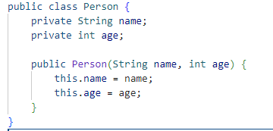
Parameterized Constructor:
Definition: A constructor with parameters.

Slide 29
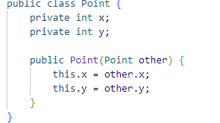
Copy Constructor
Definition: A constructor that creates a new object as a copy of an existing object.

Slide 30
Constructors Overloading
Constructor overloading is a concept in Java where a class
can have more than one constructor with different parameter
lists.
Overloaded constructors provide multiple ways to initialize
objects of a class.

Slide 31
Why Use Constructor Overloading?
Flexibility: Allows creating objects with different initial values.
Code Reusability: Reduces code duplication by reusing the constructor code with different parameters.
Better Readability: Makes the code more readable and maintainable by providing clear, meaningful constructor options.

Slide 32
public class MyClass
{
int x;
String y;
// Default constructor
public MyClass() {
x = 0;
y = "Default";
}
// Parameterized constructor
public MyClass(int a) {
x = a;
y = "Default";
}
// Another parameterized constructor
public MyClass(int a, String b) {
x = a;
y = b;
}
}

Slide 33

Benefits of Constructor Overloading:
Flexibility in Object Creation:
Real-world Scenario:
Consider a Car class where you might want to initialize a Car object with different sets of information:
Car car1 = new Car(); // Uses default constructor
Car car2 = new Car("Toyota", 2020); // Uses constructor with model and year
Car car3 = new Car("Honda", 2021, 25000); // Uses constructor with model, year, and price

Slide 34
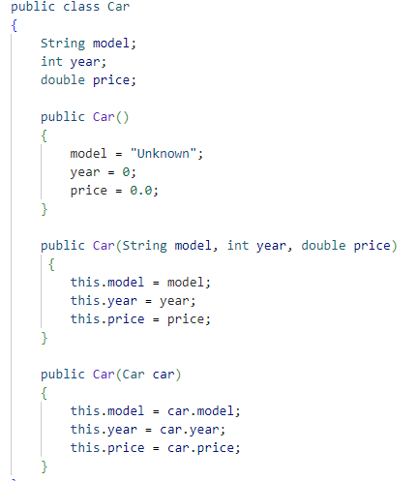

Slide 35
this keyword
The this keyword in Java is a fundamental part of object-oriented programming.
It is used in various contexts within a class to refer to the current object.

Slide 36
The this keyword is a reference variable in Java that refers to the current object.
It is used within an instance method or a constructor to refer to the current object.

Slide 37
Uses of this Keyword
To refer to the current class instance variable:
When local variables hide instance variables.
To invoke the current class method:
To avoid naming conflicts.
To invoke the current class constructor:
To call one constructor from another within the same class.
To pass the current object as a parameter to a method:
Useful in method chaining or when passing the current object.
To pass the current object as a parameter to a constructor:
Often used in creating clones or copies of objects.
To return the current object from the method:
Supports method chaining.

Slide 38
Example - Refer to Current Class Instance Variable
class Example
{
int a;
Example(int a)
{
this.a = a;
// 'this.a' refers to the instance variable
}
}

Slide 39
Invoke Current Class Method
class Example
{
void method1()
{
System.out.println("Method1");
}
void method2()
{
this.method1(); // Invokes method1 System.out.println("Method2");
}
}

Slide 40
Invoke Current Class Constructor
class Example
{ Example()
{
this(10); // Calls the parameterized constructor System.out.println("Default Constructor");
}
Example(int x)
{
System.out.println("Parameterized Constructor: " + x);
}
}

Slide 41
Pass Current Object as Parameter
class Example
{
void display()
{
System.out.println("Display Method");
}
void callDisplay()
{
method(this);
}
void method(Example e)
{
e.display();
}
}

Slide 42
Return Current Object
class Example
{
Example get()
{
return this;
}
void display()
{
System.out.println("Display Method");
}
public static void main(String[] args)
{
Example e = new Example();
e.get().display(); // Method chaining
}
}
get() returns the current object, allowing method chaining.

Slide 43
Write a Java Program to create a class Point that has two data fields x-coordinate and y-coordinate , with a constructor to initialize instance variables of a class .Write a method to calculate distance between 2 points. Also display the points. Use a concept of this keyword to return an object from a method and pass object as parameter.

Slide 44
import java.util.Scanner;
public class Pointmain
{
public static void main(String[] args)
{
Scanner sc = new Scanner(System.in);
System.out.println("Enter x1 coordinate:");
int x1 = sc.nextInt();
System.out.println("Enter y1 coordinate:");
int y1 = sc.nextInt();
Point p1 = new Point(x1, y1);
System.out.println("Enter x2 coordinate:");
int x2 = sc.nextInt();
System.out.println("Enter y2 coordinate:");
int y2 = sc.nextInt();
Point p2 = new Point(x2, y2);
double distance = p1.calculateDistance(p2);
System.out.println("Distance between the two points is: " + distance);
System.out.println("The First Point is");
p1.display();
System.out.println("The Second Point is");
p2.display();
Point p3=p1.get();
System.out.println("Third Point is")
p3.get().display(); //Method chaining
}
}

Slide 45
class Point {
private int x, y;
public Point(int x, int y)
{
this.x = x;
this.y = y;
}
public Point get()
{
return this;
}
public void display()
{
System.out.println("The X and Y coordinate of a Point is"+ x +"and"+y);
}
public double calculateDistance(Point other)
{
int dx = other.x - this.x;
int dy = other.y - this.y;
return Math.sqrt(dx * dx + dy * dy);
}
}

Slide 46
Static Members in Java
Static members (variables and methods) belong to the class rather than to any specific instance of the class.
They are shared among all instances of the class.

Slide 47
Static Variables
class Example
{
static int count = 0;
}
Explanation: count is a static variable shared by all instances of Example.
class Example
{
static int count = 0;
Example()
{
count++;
System.out.println("Count: " + count);
}
public static void main(String[] args)
{
Example e1 = new Example();
Example e2 = new Example();
Example e3 = new Example();
}
}
Explanation: Each time a new Example object is created, count is incremented and shared among all instances.

Slide 48
Static Methods
.
Declared using the static keyword.
Can be called without creating an instance of the class.
Cannot access instance variables or instance methods directly

Slide 49
Example of Static Method
class Example
{
static int add(int a, int b)
{
return a + b;
}
public static void main(String[] args)
{
int result = Example.add(5, 10); System.out.println("Result: " + result);
}
}
Explanation: The add method is static and can be called without creating an instance of Example.

Slide 50
Static Block
Used for static initialization of a class
Executed when the class is first loaded
class Example
{
static {
System.out.println("Static Block");
}
}
Explanation: The static block executes when the Example class is loaded.

Slide 51
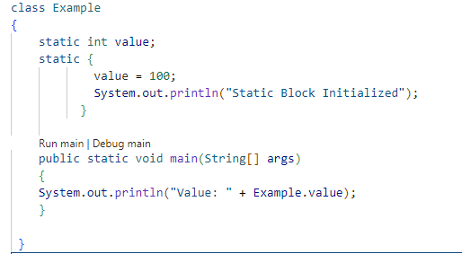
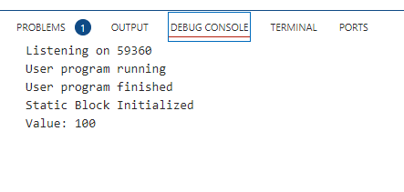
Static block
Output

Slide 52
String class
In Java, the String class is a fundamental part of the language, used to represent sequences of characters.
It's part of the java.lang package and provides a wide array of methods for manipulating and querying strings.

Slide 53
Key Characteristics
Immutable: Once a String object is created, it cannot be modified. Any operation that seems to modify a string will actually create a new String object.
Interning: Java optimizes memory usage by maintaining a pool of strings. If you create a string with the same value, Java reuses the existing object from the pool.

Slide 54
Creating Strings
Strings in Java can be created using:
String literals
String str1 = "Hello, World!";
The new keyword
String str2 = new String("Hello, World!");

Slide 55

length():
String str = "Hello, World!";
int length = str.length(); // 13
substring(int beginIndex, int endIndex)
String sub = str.substring(7, 12); // "World"

Slide 56
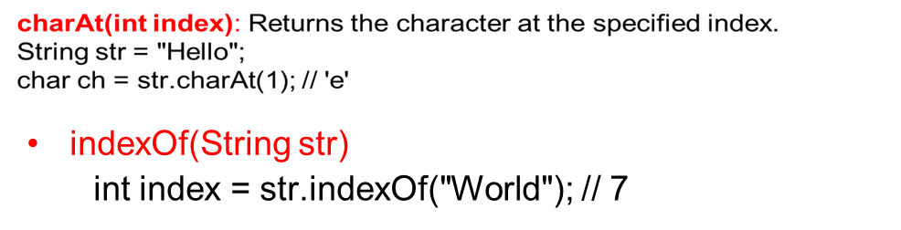
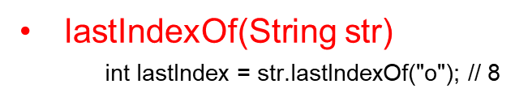
toLowerCase()
String lower = str.toLowerCase(); // "hello, world!"
toUpperCase()
String upper = str.toUpperCase(); // "HELLO, WORLD!"
trim()
String padded = " Hello, World! ";
padded.trim(); // "Hello, World!"

Slide 57
replace(CharSequence target, CharSequence replacement)
String replaced = str.replace("World", "Java"); // "Hello, Java!"
split(String regex)
String[] parts = str.split(", "); // ["Hello", "World!"]
concat(String str)
String greeting = "Hello";
String name = "Alice";
String message = greeting.concat(", ").concat(name); // "Hello, Alice"
String toUpperCase()
String upperStr = str1.toUpperCase(); // "HELLO, WORLD!"
String toLowerCase()
String lowerStr = str1.toLowerCase(); // "hello, world!"
equals(Object anObject)

Slide 58
startsWith(String prefix)
boolean starts = str.startsWith("Hello"); // true
endsWith(String suffix)
boolean contains(CharSequence s)
boolean containsHello = str1.contains("Hello"); // true
int indexOf(String str): Returns the index within this string of the first occurrence of the specified substring.
int index = str1.indexOf("World"); // 7
int lastIndexOf(String str): Returns the index within this string of the last occurrence of the specified substring.
int lastIndex = str1.lastIndexOf("o"); // 8

Slide 59
static String join(CharSequence delimiter, CharSequence... elements)
Returns a new String composed of copies of the CharSequence elements joined together with a copy of the specified delimiter.
String joinedStr = String.join(", ", "Hello", "World"); // "Hello, World"
These methods are part of the comprehensive String class in Java, providing powerful tools for string manipulation and processing.

Slide 60
Thanks!
Any questions?
You can find me at:
pritii.bokariyya@gmail.com

Slide 61
Credits
Java, The Complete Reference, TMH
Tutorials and Forums available on Internet

